Slide 1

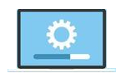

Slide 2
About today…
React.js
Installation & Setup
Writing first component

Slide 3

Setting Up Environment
Download the Node.js installer from the official website.
Run the installer and follow the installation instructions

Slide 4
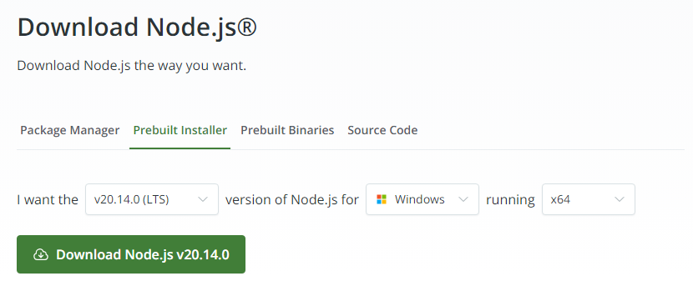
https://nodejs.org/en/download/prebuilt-installer

Slide 5
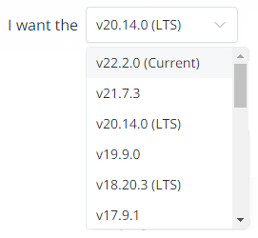
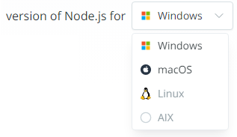
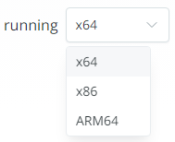

https://nodejs.org/en/download/prebuilt-installer

Slide 6
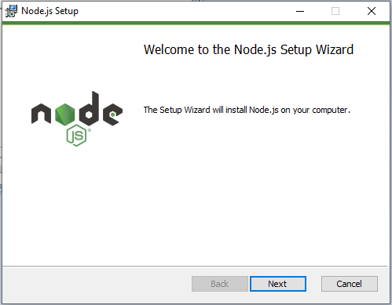

Slide 7
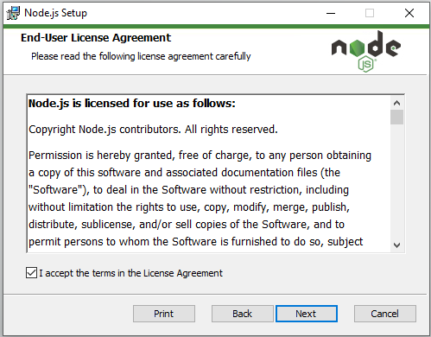

Slide 8
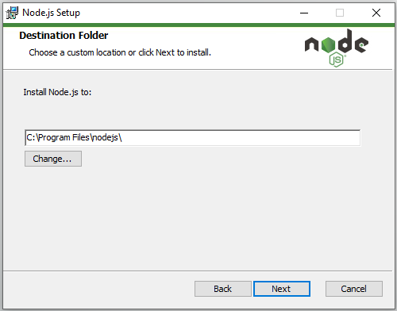

Slide 9
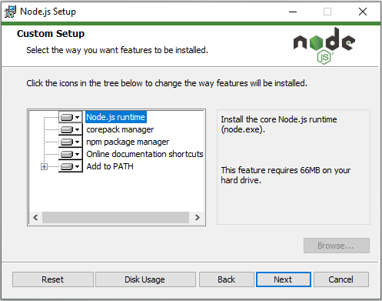

Slide 10
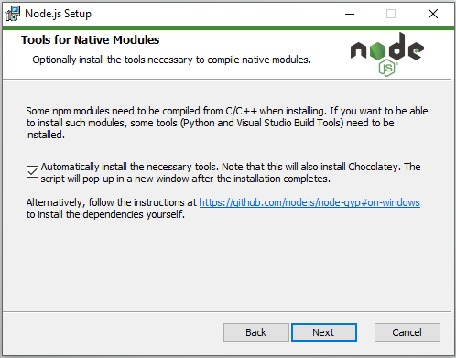

Slide 11
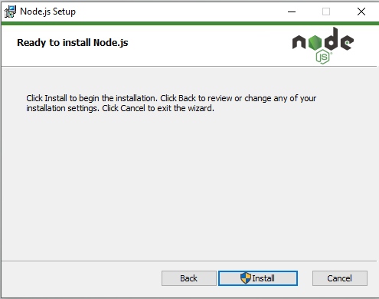

Slide 12
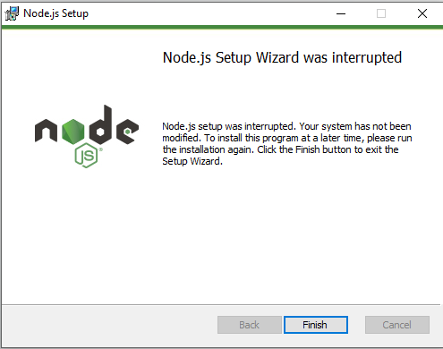

Slide 13
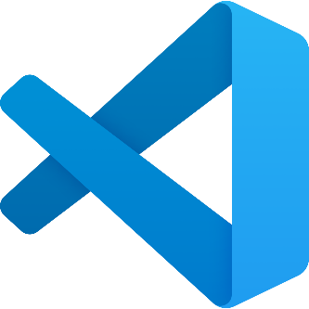
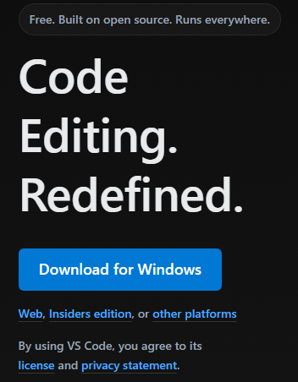


Verify Node.js installation using following command
in the terminal
Visual Studio Code
Download Visual Studio Code from Official Website
https://code.visualstudio.com/

Slide 14
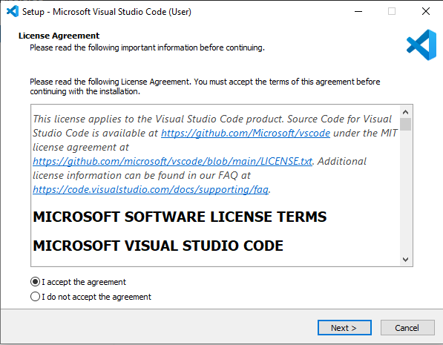

Slide 15
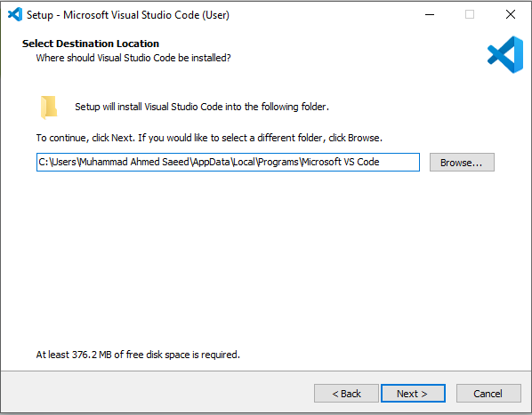

Slide 16
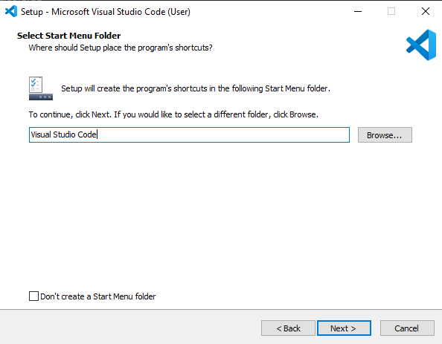

Slide 17
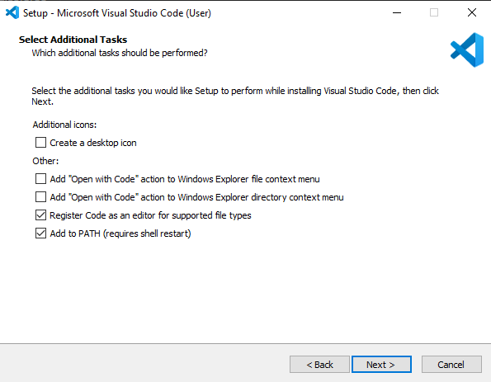

Slide 18
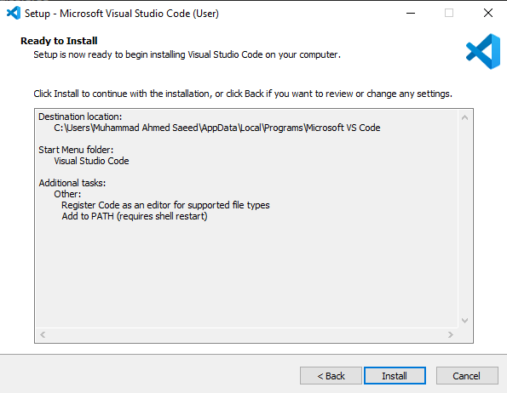

Slide 19
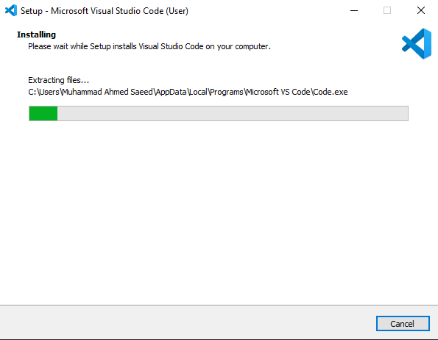

Slide 20
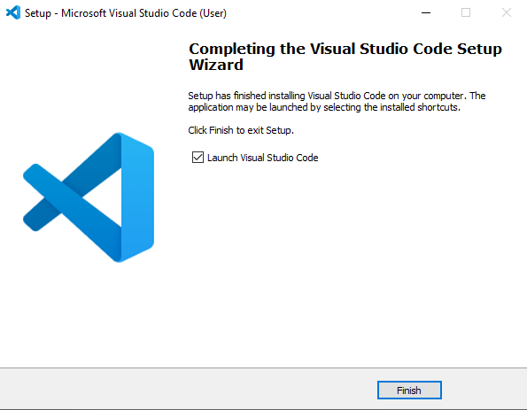

Slide 21


Create first node program
Output

Slide 22

Setting Up React Environment

Slide 23


Setup React Environment
Use create-react-app to set up a new React project quickly
Navigate into your project directory
By browsing through VSCode
By command prompt

Slide 24
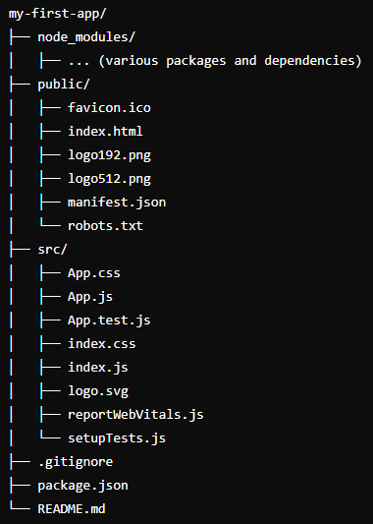
Understanding Project Structure
node_modules/
Contains all the npm packages installed
public/
Static assets like HTML file
index.html
Main HTML file
favicon.ico
Icon displayed in the browser tab
src/
Contains the source code
App.js
Main component of the application
index.js
Entry point of the React application
App.css
Styles for the App component
package.json
Lists project dependencies and scripts
README.md
Contains information about the project

Slide 25

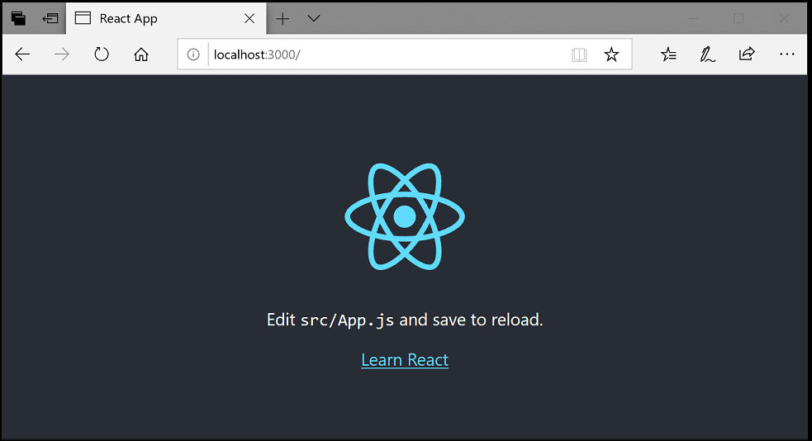
Starting the Development Server
Start the React application using npm
The development server runs at http://localhost:3000
Open a browser and navigate to the URL to see your React app

Slide 26
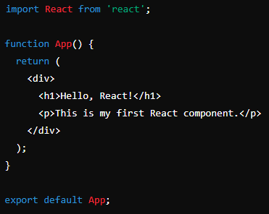
Writing first component
Open src/App.js file
Replace existing code with this one :
Run the development server and view changes in the browser

Slide 27


Slide 28

What command is used to create a new React application using Create React App?
Which directory contains the main HTML file of a Create React App project?
What is the entry point file for a React application?
What is the purpose of the ‘package.json’ file in a React project?
Which command is used to start the development server for a React application?

